Slide 1
Module, meet Blockchain
Nik Kalyani

Slide 2











Please support our valuable sponsors

Slide 3

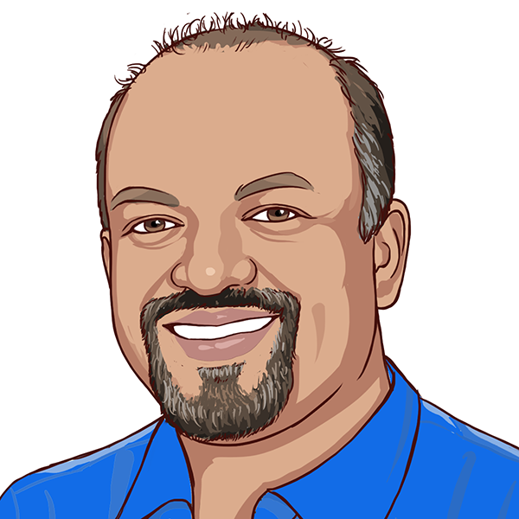




NIK KALYANI
Co-founder/CTO

Slide 4
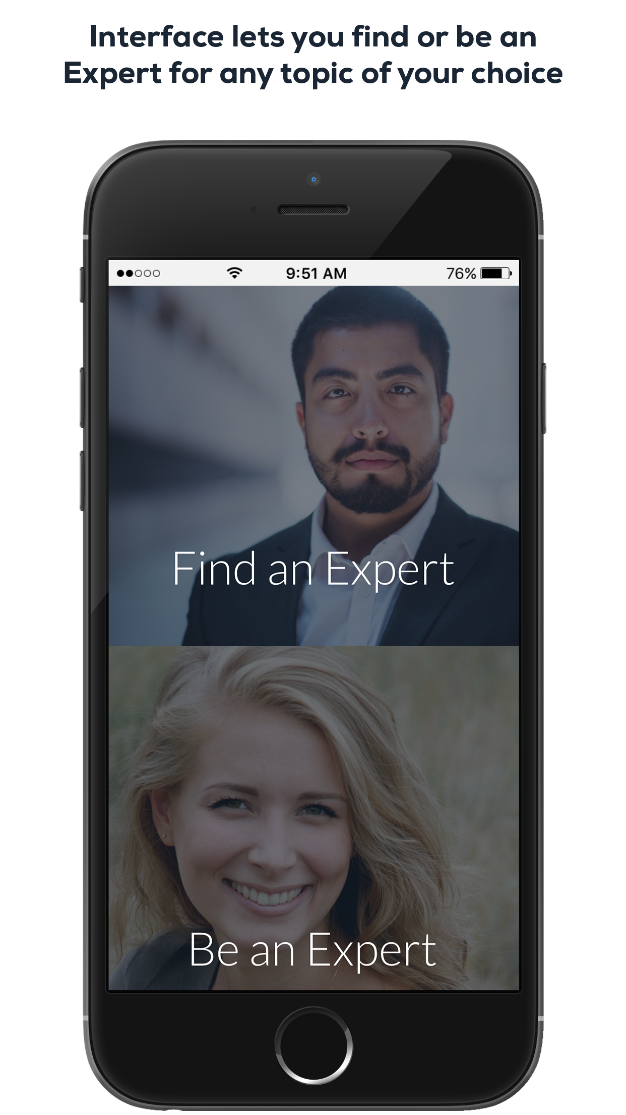
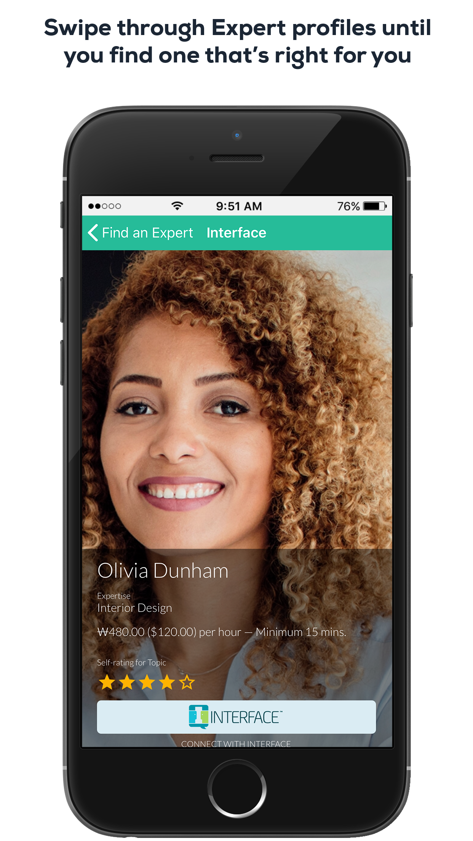
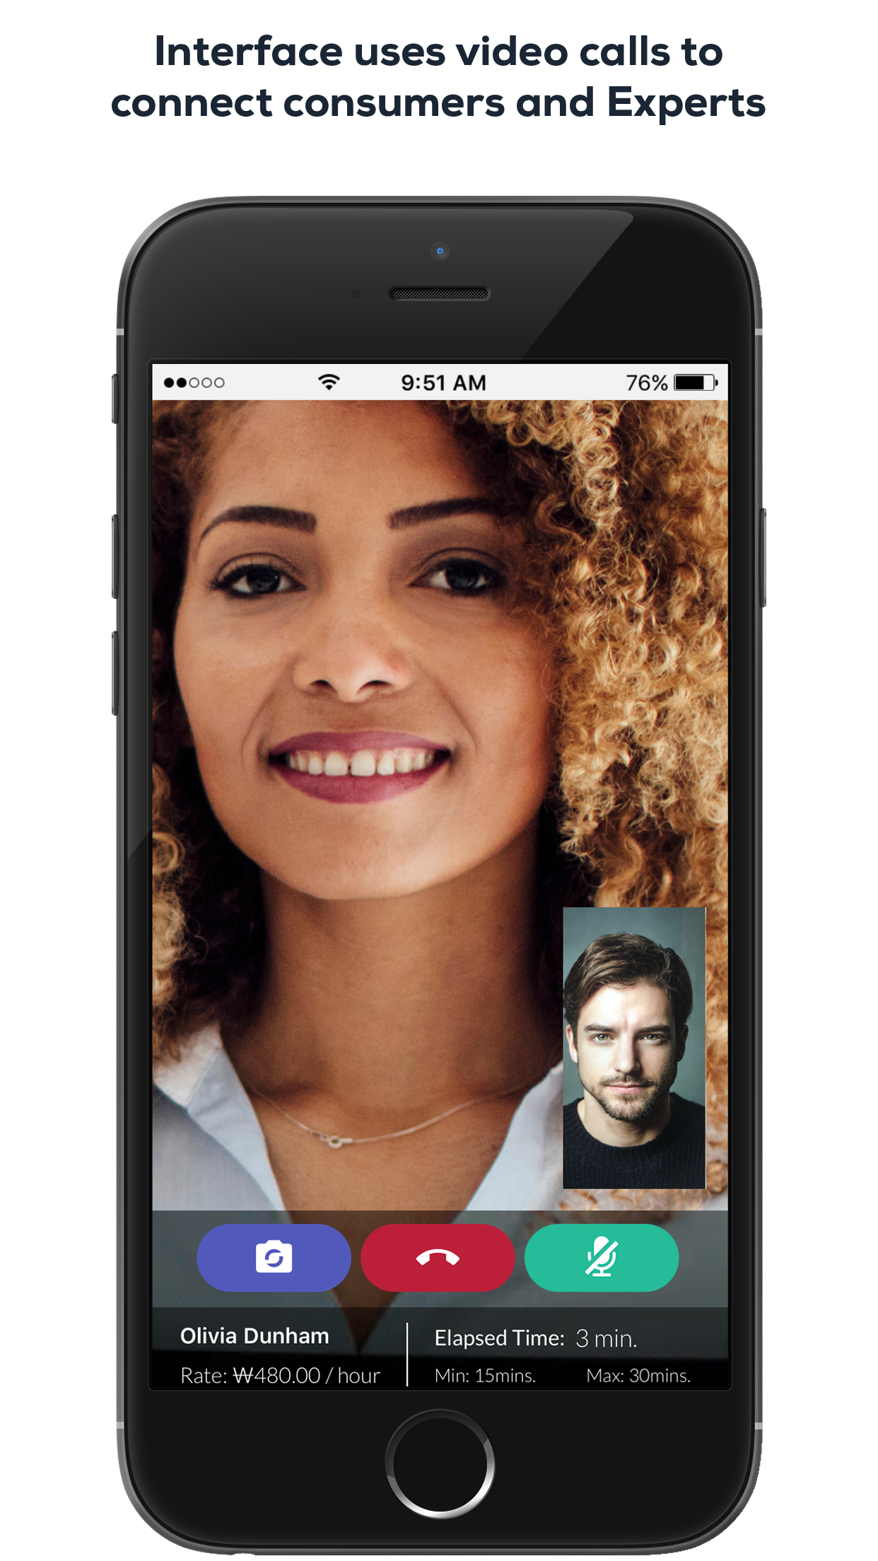

WHENHUB
40,000
downloads
interface.whenhub.com

Slide 5
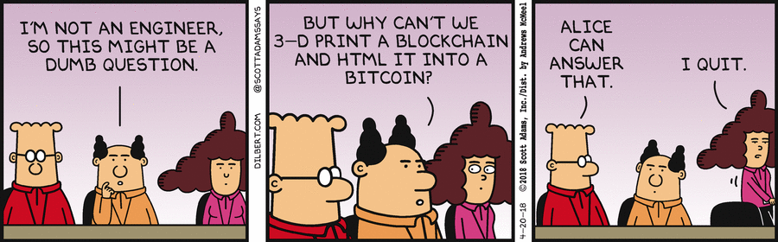

Slide 6
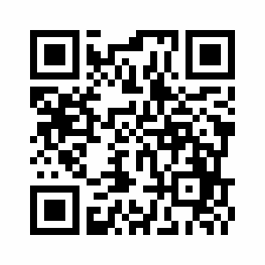
CODE & SOCIAL MEDIA
https://tinyurl.com/dnnconnect-2018
@techbubble
#DNNConnect2018
#SmartContracts

Slide 7
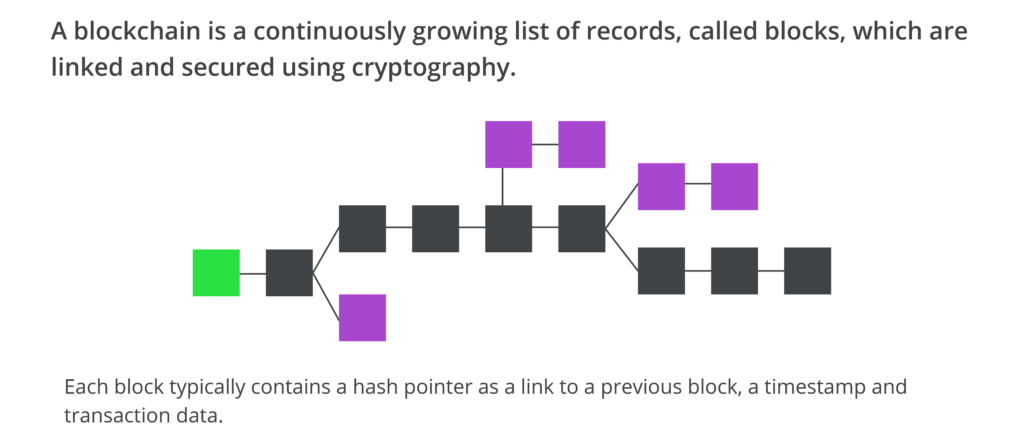
BLOCKCHAIN

Slide 8
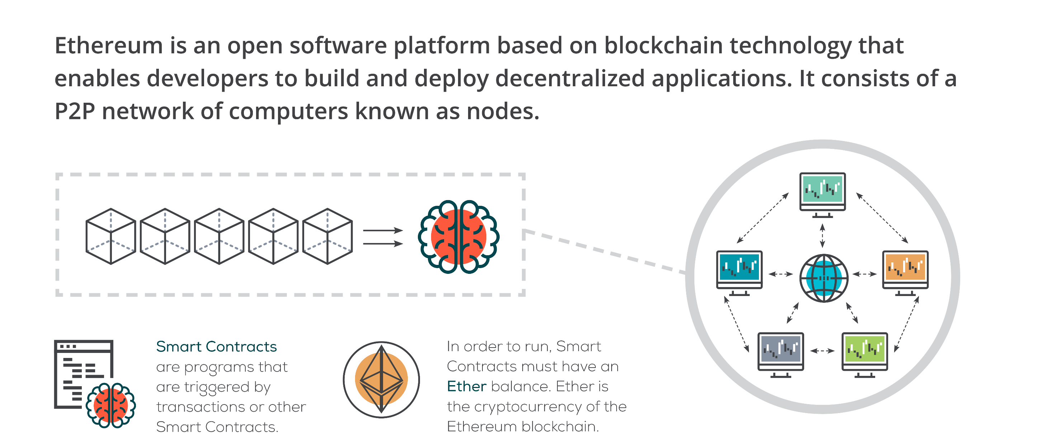
ETHEREUM

Slide 9
BUILDSTARTER
Like Kickstarter, but for Open Source where the community funds features with cryptocurrency that that team should build
Anyone can propose a feature for a small registration fee by calling “register”
Features have a funding goal and funding deadline
Anyone can call “fund” and contribute toward the funding goal
When the funding deadline passes, two conditions exists:
Funding goal met or exceeded – Anyone can call “settle” and transfer funds to the owner of the feature
Funding goal not met – Anyone who contributed can call “refund” and get their funds back

Slide 10
WORKFLOW
Develop and Test with Local Blockchain
Deploy and Test with Ropsten Blockchain
Deploy and Test with Mainnet Blockchain

Slide 11
SMART CONTRACT
TRUFFLE
Solidity Source Code
Ganache
Mocha
Chai

Slide 12
DAPP (DECENTRALIZED APP)
METAMASK
HTML/CSS/JS
Ganache
Web3JS

